Slide 1
Agile Methodology
Submitted to:: Satish Mahajan
Harpreet Saini
Smriti Sharma
Ayesha
Aditi Ghosh
Manu Sharma

Slide 2

Introduction and core values of Agile

Slide 3
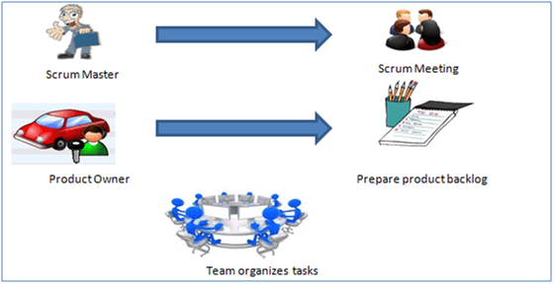
Introduction to SCRUM

Slide 4
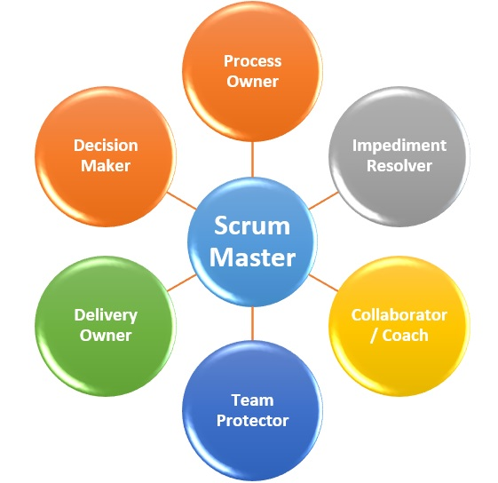
Role of master in SCRUM

Slide 5
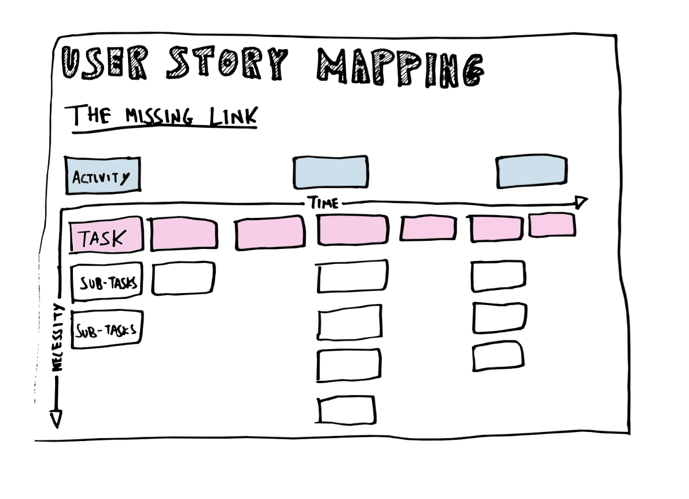
USER STORIES

Slide 6
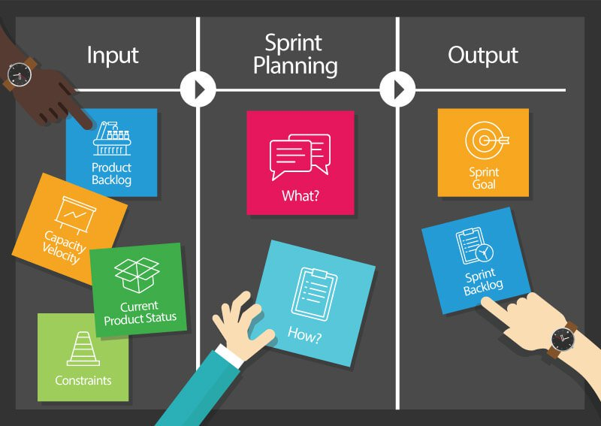
SPRINT PLANNING

Slide 7
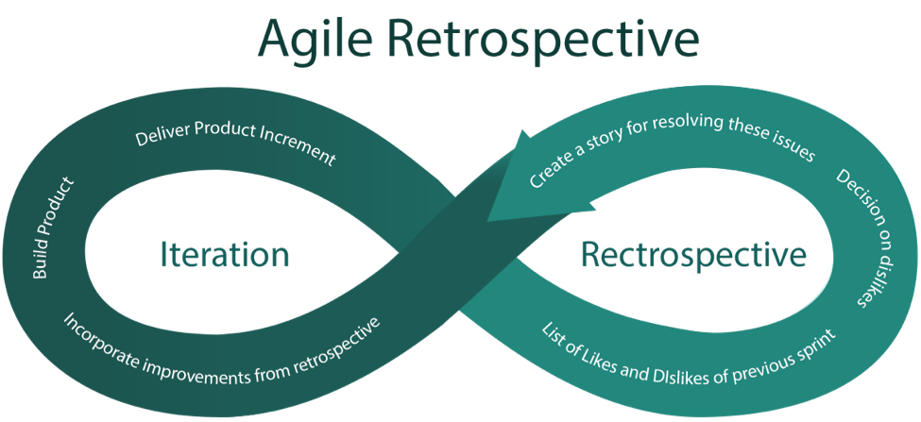
RETROSPECTION
An agile retrospective, or sprint retrospective as Scrum calls it, is a practice used by teams to reflect on their way of working, and to continuously become better in what they do.

Slide 8
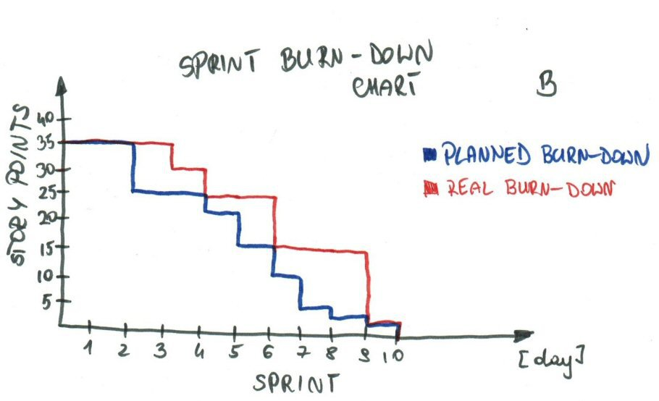
BURN DOWN CHART

Slide 9
Sprint Burn down Chart
The Sprint Burn down Chart makes the work of the Team visible.
It is a graphic representation of the rate at which work is completed and how much work remains to be done.

Slide 10
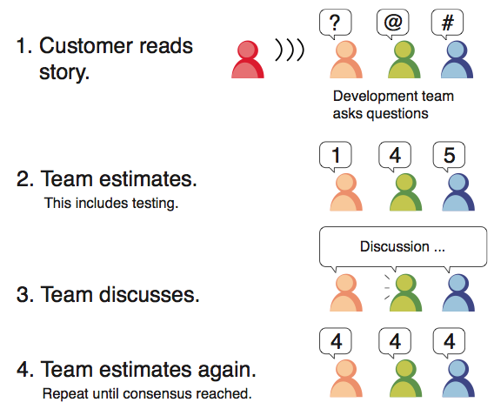
POKER PLANNING

Slide 11
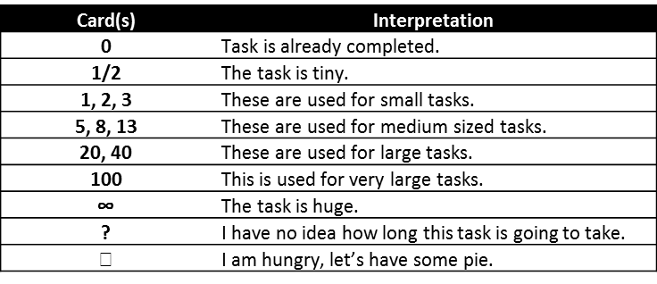
THE CARDS HAVE THESE VALUES WHICH REPRESENT STORY POINTS FOR THE USER STORIES.

Slide 12
DAILY STAND UP
Are daily scrum meetings
Key Points
What I did Yesterday?
What I will do today?
What obstacles I am facing?

Slide 13
KANBAN
Kanban Software Tools.
Kanban is a method for managing the creation of products with an emphasis on continual delivery.
Kanban is a process designed to help team members work together more effectively.

Slide 14
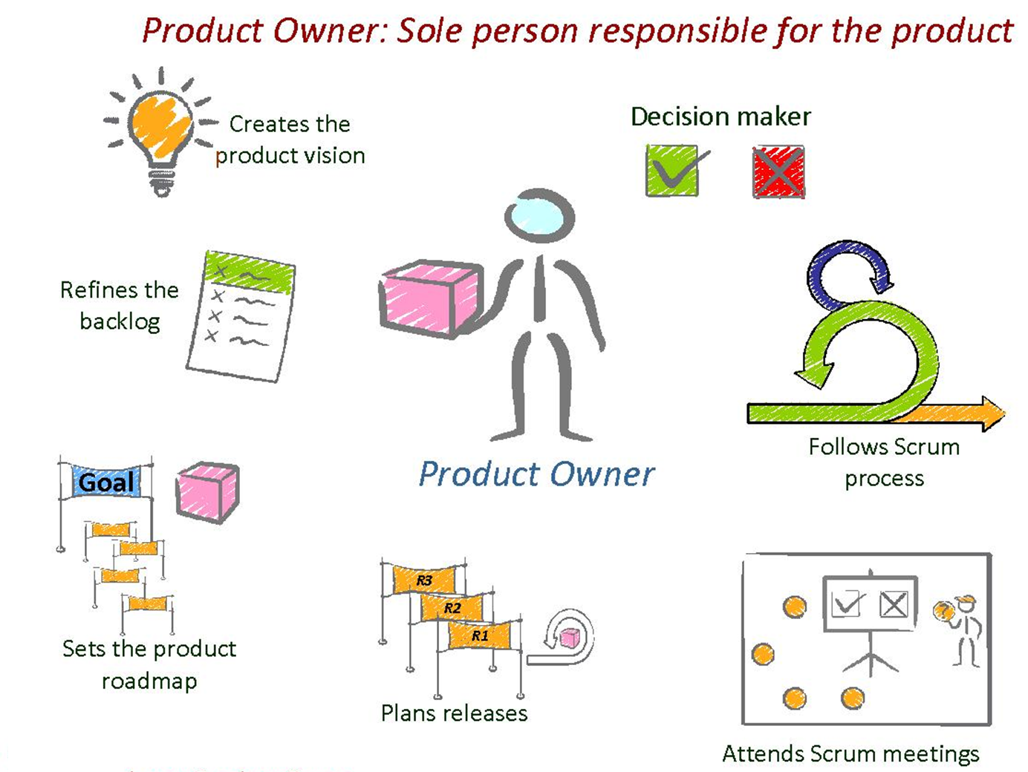
ROLE OF PRODUCT OWNER

Slide 15
VELOCITY
Velocity is a measure of the amount of work a Team can tackle during a single Sprint. Velocity is calculated at the end of the Sprint by totaling the Points for all fully completed User Stories.
Points from partially-completed or incomplete stories should not be counted in calculating velocity. Velocity should be tracked throughout the Sprint on the Sprint Burn down Chart and be made visible to all Team members. The slides below give a nice overview of how metrics are made visible

Slide 16
SPRINT BACKLOG
The Sprint Backlog is the set of Product Backlog items selected for the Sprint, plus a plan for delivering the product Increment and realizing the Sprint Goal.
The Sprint Backlog is a forecast by the Development Team about what functionality will be in the next Increment and the work needed to deliver that functionality into a “Done” Increment.

